Slide 1


Slide 2
Trainer Guidelines for Conducting Class
Solve questions live by creating new blank files (Excel, Python, Jupyter notebook, Dashboard) during the session, rather than sharing completed solutions.
Review teaching materials and solutions beforehand, and prepare additional examples to reinforce learning.
Ensure online students can hear you and see the screen clearly at all times.
Test your computer and necessary software before class begins.
Check with online students every 15-20 minutes to see if they understand the material and have any questions.

Slide 3

Day 3: Agenda
Introduction To NumPy
Creating NumPy Array
Basic Operation On Array
Indexing & Slicing
Reshaping, Stacking & Splitting
Iteration, Filtering & Boolean Indexing
NumPy Case Study
Data Structure In Pandas
Series & Dataframe
Creating Dataframe & Loading Files (Scv, Excel, Sql Etc)

Slide 4

NumPy (Numerical Python)
NumPy (Numerical Python) is a fundamental library in Python for numerical and scientific computing.
It provides support for arrays, matrices, and a wide range of mathematical functions to work efficiently with large datasets and perform various mathematical operations.
NumPy is suited for many applications:
Image Processing
Signal Processing
Linear Algebra
A Plethora of Others

Slide 5
Key Features - NumPy
Multidimensional Arrays: NumPy's numpy.ndarray supports n-dimensional arrays for scientific computing.
Element-Wise Operations: Perform efficient element-wise operations on arrays without explicit loops.
Broadcasting: Automatically aligns arrays of different shapes for operations.
Mathematical Functions: Offers a wide range of mathematical functions, including basic arithmetic, trigonometry, and statistics.
Random Number Generation: Provides tools for generating random data, crucial for simulations and stats.
File I/O: Supports reading/writing data from/to files, such as CSV and binary formats.
Integration: Often used with other libraries like Pandas, SciPy, and Matplotlib.

Slide 6
Creating NumPy Array
Creating NumPy Arrays:
1. From Lists or Tuples:
import numpy as np
arr = np.array([1, 2, 3, 4, 5])
2. Using Built-in Functions:
zeros_arr = np.zeros((3, 3)) # Creates a 3x3 array filled with zeros
ones_arr = np.ones((2, 2)) # Creates a 2x2 array filled with ones
3. Arange and Linspace:
arr = np.arange(0, 10, 2) # Creates an array [0, 2, 4, 6, 8]
lin_arr = np.linspace(0, 1, 5) # Creates an array [0. , 0.25, 0.5 , 0.75, 1. ]

Slide 7
Creating NumPy Array
Creating NumPy Arrays:
4. Random Arrays:
rand_arr = np.random.rand(3, 3)
# Creates a 3x3 array with random values between 0 and 1

Slide 8
Creating NumPy Array
Using dimesion to genertate N-dimensional arrays:
arr = np.array([1,2,3,4], ndmin=2)
print(arr)
print(arr.reshape((2,2))) # to change the shape of the array | *NEED* to only provide the shape with matches the number of elements in the array
print(type(arr)) # to check the type of the class for the given object
print(arr.shape) # to check the shape of the arr | *shape* given info about rows and cols, helpful in matrix algebra
print(arr.ndim) # to check the dimentions of the arr

Slide 9
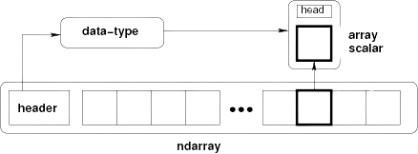
Array Memory Layout

Slide 10
NumPy
DataTypes in NumPy:
Strings e.g. 'ABC'
Integers e.g. 1
float e.g. 5.98
boolean e.g. True
complex e.g. 1.0 + 2.0j
Data Type Codes:
i – integer, b – Boolean, u - unsigned integer, f – float, c - complex float, m – timedelta, M – datetime, O – object, S – string, U - unicode string, V - fixed chunk of memory for other type ( void )
arr = np.array([1,2,3,4])
print(arr.dtype) # int32
arr = np.array(['dogs','cats','horses'], dtype='S') # to initalize with a specific datatype
print(arr.dtype)
→ int32
→ |S6

Slide 11
Indexing and Slicing NumPy Arrays
Indexing and Slicing NumPy Arrays:
NumPy arrays can be accessed and sliced similar to Python lists, with the additional ability to index and slice in multiple dimensions for multi-dimensional arrays.
import numpy as np
arr = np.array([[1, 2, 3], [4, 5, 6], [7, 8, 9]])
# Accessing elements
element = arr[0, 1] # Accessing the element at the first row and second column
slice_ro# Slicing
w = arr[1, :] # Slicing the second row
slice_column = arr[:, 2] # Slicing the third column
# Advanced indexing
mask = arr > 5 # Creating a boolean mask for values greater than 5
filtered = arr[mask] # Getting values greater than 5

Slide 12
NumPy
import numpy as np
# Create the following rank 2 array with shape (3, 4)
[[ 1 2 3 4]
[ 5 6 7 8]
[ 9 10 11 12]]
a = np.array([[1,2,3,4], [5,6,7,8], [9,10,11,12]])
# Use slicing to pull out the subarray consisting of the first 2 rows and columns 1 and 2; b is the following array of shape (2, 2):
[[2 3]
[6 7]]
b = a[:2, 1:3]
# A slice of an array is a view into the same data, so modifying it will modify the original array.
print(a[0, 1]) # Prints "2"
b[0, 0] = 77 # b[0, 0] is the same piece of data as a[0, 1]
print(a[0, 1]) # Prints "77"

Slide 13
NumPy Operations
NumPy Operations:
NumPy arrays support a wide range of operations, including arithmetic, statistical, and more. These operations are performed element-wise.
import numpy as np
arr1 = np.array([1, 2, 3])
arr2 = np.array([4, 5, 6])
# Element-wise arithmetic operations
addition = arr1 + arr2
subtraction = arr1 - arr2
multiplication = arr1 * arr2
division = arr1 / arr2
# Statistical operations
mean = np.mean(arr1)
std_dev = np.std(arr2)

Slide 14
NumPy Operations
# Geometric operations
exponentiation = np.exe(arr1)
sq_root = np.sqrt(arr1)
sin = np.sin(arr1)
cos = np.cos(arr1)
log = np.log(arr1)
# Agregate Functions
arr1.sum()
arr1.min()
arr1.max()

Slide 15
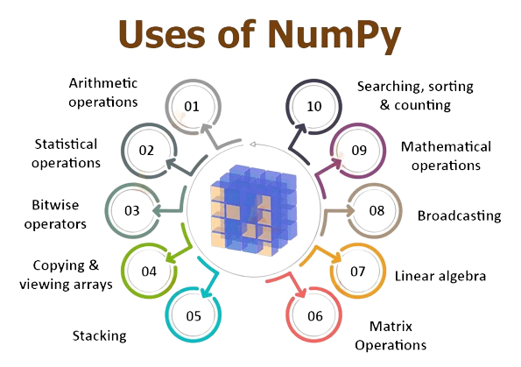
Application of NumPy
Application of NumPy
Data Analysis and Manipulation
Scientific and Engineering Computations
Machine Learning and Deep Learning
Image and Signal Processing
Statistical Analysis
Simulation and Modeling
Financial and Economic Analysis
Geospatial Data Analysis
Bioinformatics
Data Visualization
Physics and Astronomy
Materials Science
Neuroscience
Environmental Science
Astronomy

Slide 16
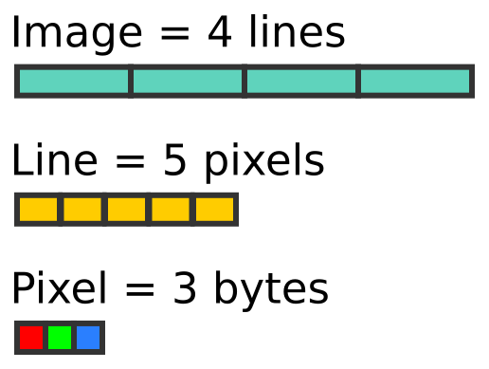
NumPy – Case Study
Image Processing using NumPy & Matplotlib
The fundamental idea is that we know images are made up of NumPy ndarrays. So we can manipulate these arrays and play with images.
Matplotlib: Matplotlib is a popular Python library for creating static, animated, and interactive visualizations in various formats, such as charts, plots, and graphs.
PIL (Python Imaging Library): PIL, also known as Pillow, is a library for working with images in Python, allowing you to open, manipulate, and save various image file formats.
# importing all the required libraries for Image Processing
import numpy as np
import matplotlib.pyplot as plt
from PIL import Image, ImageOps

Slide 17

Pandas Introduction
Pandas is a Python library designed for data manipulation and analysis.
It offers powerful DataFrame and Series data structures.
Pandas simplifies data tasks, from reading and cleaning data to analysis and visualization.
Throughout this presentation, we'll explore how Pandas revolutionizes data work

Slide 18
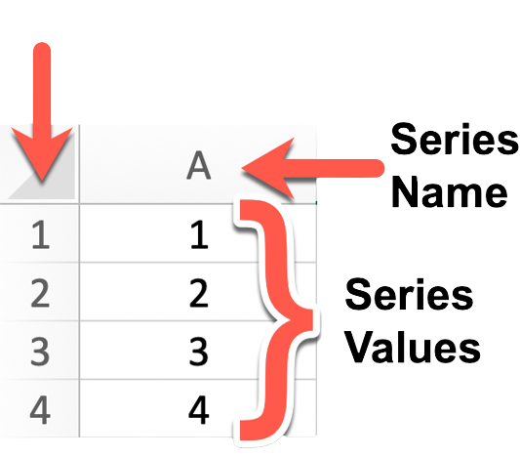
Data Structure in Pandas
Panda Series
A Pandas Series is a one-dimensional array-like data structure that can hold data of various types, including integers, floats, strings, and more.
It's essentially a labeled array where each element has an associated index or label. This label allows for easy data access and manipulation.

Slide 19
Pandas Series
Creating a Pandas Series:
import pandas as pd
# Creating a Series from a list
data = [10, 20, 30, 40, 50]
series_from_list = pd.Series(data)
# Creating a Series from a NumPy array
import numpy as np
numpy_array = np.array([1, 2, 3, 4, 5])
series_from_numpy = pd.Series(numpy_array)
# Creating a Series with custom index labels
custom_index = pd.Series(data, index=['A', 'B', 'C', 'D', 'E'])

Slide 20
Pandas Series
Indexing a Pandas Series:
# Accessing elements by position (zero-based index)
element_at_position_2 = series_from_list[2]
# Accessing elements by label
element_with_label_B = custom_index['B']
# Slicing a Series
slice_series = series_from_list[1:4] # Returns elements at positions 1, 2, and 3

Slide 21
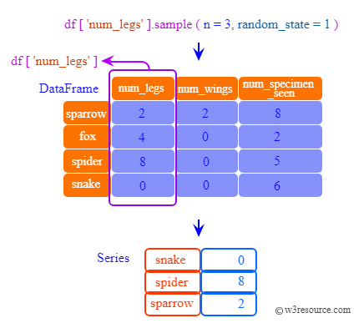
Pandas DataFrame
A Pandas DataFrame is a two-dimensional, tabular data structure that resembles a spreadsheet or SQL table. It consists of rows and columns, where each column can contain different data types.
DataFrames are especially well-suited for handling structured data, such as datasets with rows and columns of information.

Slide 22
Creating Pandas DataFrame
import pandas as pd
# Creating a DataFrame from a dictionary
data = {'Name': ['Alice', 'Bob', 'Charlie'],
'Age': [25, 30, 35]}
df_from_dict = pd.DataFrame(data)
# Creating a DataFrame from a list of lists with custom column names
data_list = [['Alice', 25], ['Bob', 30], ['Charlie', 35]]
df_from_list = pd.DataFrame(data_list, columns=['Name', 'Age'])
# Creating a DataFrame from a CSV file
df_from_csv = pd.read_csv('data.csv')
# Creating an empty DataFrame
empty_df = pd.DataFrame()

Slide 23
Indexing a Pandas DataFrame
DataFrames allow for various methods of indexing, including selecting columns, filtering rows, and more.
# Selecting a single column
name_column = df_from_dict['Name']
# Selecting multiple columns
subset = df_from_dict[['Name', 'Age']]
# Filtering rows based on a condition
young_people = df_from_dict[df_from_dict['Age'] < 30]
# Accessing a specific cell by row and column label
cell_value = df_from_dict.at[0, 'Name']

Slide 24
Loading Data from Files
CSV Files: CSV (Comma-Separated Values) files are one of the most frequently used formats for tabular data.
import pandas as pd
# Reading a CSV file
data = pd.read_csv('data.csv')
Excel Files: Pandas can read data from Excel files with multiple sheets and various formats.
# Reading an Excel file (first sheet by default)
data_from_excel = pd.read_excel('data.xlsx')
# Reading a specific sheet from an Excel file
data_from_sheet2 = pd.read_excel('data.xlsx', sheet_name='Sheet2')

Slide 25
Loading Data from Files
SQL Databases: You can connect to SQL databases and retrieve data using Pandas.
from sqlalchemy import create_engine
# Create a database connection
engine = create_engine('sqlite:///database.db')
# Read data from a SQL database
data_from_sql = pd.read_sql_query('SELECT * FROM table_name', engine)
JSON Files: JSON (JavaScript Object Notation) files are commonly used for semi-structured data.
# Reading data from a JSON file
data_from_json = pd.read_json('data.json')
HTML/Web Scraping: You can also scrape data from HTML tables on webpages.
# Reading tables from a webpage
data_from_html = pd.read_html('https://example.com')[0] # Adjust index as needed

Slide 26
Thank You!!!

